Slide 1

Overview of Behavior Assessment and Behavior Change Planning
Module 6

Slide 2
Topics to be Covered in this Presentation
Behavior assessment in the classroom
Overview of functional behavioral assessments (FBA)
Overview of behavior intervention plans (BIP)

Slide 3

Reflection
Watch this video and reflect on how it may impact your teaching and educational management of students with various exceptionalities.
Brainhighways. (2015). Dear teacher: Heartfelt advice for teachers from students. Retrieved from https://youtu.be/lTMLzXzgB_s

Slide 4
Previously in Module 5, we looked at ways to successfully deal with more extensive behavior issues. If these repeatedly occur, then behavioral assessment and behavioral intervention planning may be required. These may also be required and for some students with particular exceptionalities. Module 6 in this presentation provides brief overviews of these issues. Please note that you will examine them more fully in an upcoming course.
Let’s get started!

Slide 5
Behavior Assessment in the Classroom

Slide 6
Behavior Assessment in the Classroom
Throughout this course, you have learned about the teacher’s thinking process regarding the management of the classroom to facilitate the learning of all students Part and parcel of this thinking process, although it is not often put into words, is the assessment of student behavior. While it may not be a formally defined process, it nevertheless goes on in every classroom around the world.

Slide 7
Behavior Assessment in the Classroom (cont.)
Just because it is not a formal process does not mean that it is not a powerful tool both for the teacher and for the student. Using this informal observation and planning process leads to well-run classrooms in which students can learn and flourish.

Slide 8
Behavior Assessment in the Classroom (cont.)
As you have seen in the prior module, there are times when such an informal process of assessing student behavior may need a little help
If or when that becomes the case, it is time to think a little broader and a little more formally
  It is time to turn to the functional behavioral assessment (FBA) process

Slide 9
Functional Behavioral Assessment (FBA)

Slide 10
What Is the Function of This Behavior?
Bedirhanoglu, A. (2006). Fake crying baby. Retrieved from https://youtu.be/uQtpRjBLXic

Slide 11
FBA is a Function Based Approach
It is a process that focuses on:
  Changing environmental factors instead of fixing the person

Slide 12
When you consider why any person does anything, it can be boiled down very simply . . .
There are only two functions of human behavior!

Slide 13
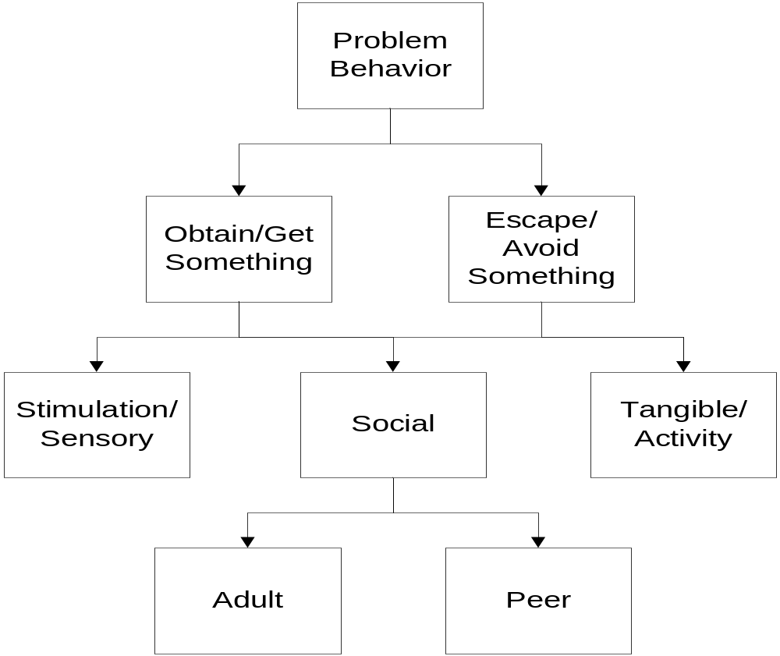
Only Two Basic Functions of Behavior
Positive
Reinforcement
Negative
Reinforcement
from Horner & Sugai at www.pbis.org
Notes:
For example-
Many students use off topic comments/inappropriate language to obtain
attention from peers through their reactions and to escape the task at hand.
In this example, social reinforcement is obtained from the peers and the
adult.
Remember reinforcement is positive and negative.
NOTE:
When control is offered as a possible function- think about what is underlying that perception.
Control can be a way:
To hide skill deficits; therefore escaping/avoiding a task
To hide fears around social acceptance; therefore escaping/avoiding a situation
For an individual to assert themselves; therefore gaining/obtaining the attention of peers/adults

Slide 14
Knowing this, just what is involved in completing a functional behavioral assessment for a student?

Slide 15
FBA
Involves observations of the student in his/her natural environments
It determines why problems occur
It develops testable explanations
The purpose is to get the information necessary to create a successful plan to tackle unwanted behavior
These plans focus primarily on prevention

Slide 16
Another way of looking at the FBA process is to
ERASE the behavior.

Slide 17
ERASE Problem Behaviors
Explain - What is the problem?
Reason - What is he/she getting out of it or avoiding?
Appropriate - What do you want him/her to do instead?
Support - How can you help this happen more often?
Evaluate - How will you know if it works?
Notes:
17

Slide 18
There are 5 Steps in Conducting a FBA
Define the problem behavior
Gather information
Generate a hypothesis
Build a competing behavior pathway
  This is an acceptable alternate behavior, placing both the teacher and student in a
  WIN-WIN scenario
Design the behavior intervention plan

Slide 19
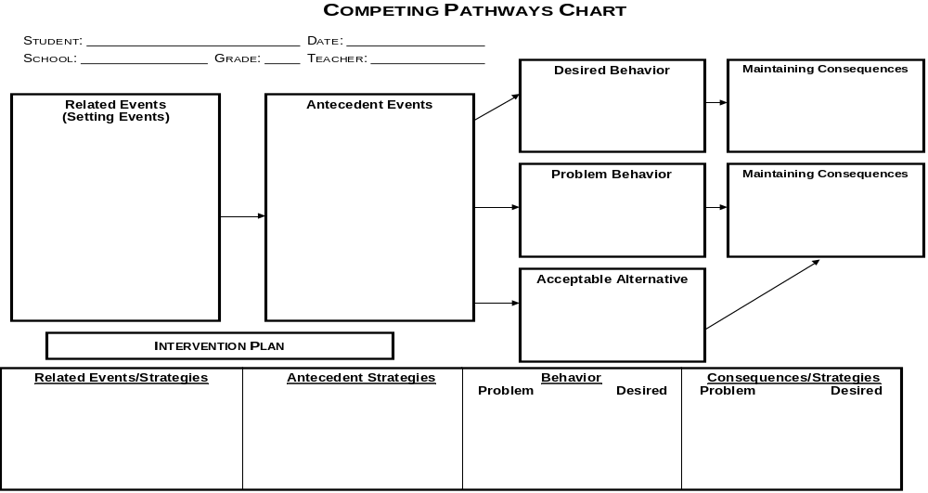
Adapted from Sugai, Lewis-Palmer, & Hagan, 1999
Notes:
The Competing Pathways Chart serves is a visual organizer of the FBA/BIP process.
Identify what the student should be doing instead of the problem behavior
Focus on appropriate, pro-social behaviors that serve the same function
Choose a behavior that is observable and measurable
Review: The problem behavior identified for the case study is that the student responds using inappropriate words, tone, and body language when interacting with both adults and peers.
Have small groups use the Competing Pathways Chart to generate an appropriate replacement behavior.
Spend a few minutes reviewing desired and acceptable alternative behaviors focusing on the fact that the behavior must serve the same function, be efficient, and relevant to the student.

Slide 20
And Then What?
After the FBA process is completed, the team can then create a Behavior Intervention Plan (BIP)
Once it is implemented, it must be closely monitored to determine when the suggested replacement strategies are improving the desired behavior for the student
If this is found NOT to be true, the team must repeat the process until a desired outcome is determined

Slide 21
Additional Information - FBA
As explained near the beginning of the presentation, the FBA/BIP process will likely be mandates for students who continue to exhibit behavior issues that are disruptive to the learning environment
In some portions of the country and with some states, the FBA/BIP process is also mandated for students with certain exceptionalities that often manifest behavioral issues, such as:
  Emotional Behavioral Disorder (EBD)
  Autism
  Some students with Intellectual Disabilities (InD)
Note that the FBA/BIP process is NOT just for students in special education; it is available to ALL students including those in the general education environment
If the student with a FBA/BIP receives special education services, then the BIP is reviewed annually as part of the annual IEP process

Slide 22
Behavior Intervention Plan (BIP)

Slide 23
Once You Have the FBA, What is Next?
Once the team has developed the FBA, then a behavioral change plan is developed and put into effect
  This is called the Behavior Intervention Plan (BIP)

Slide 24
Watch the brief but thorough video on the next slide to get an overview of the BIP process as it relates to the FBA.

Slide 25
Overview of the Behavior Implementation Plan (BIP) Process
Teachings in Education. (2017). Behavior implementation plan: BIP overview. Retrieved from https://youtu.be/AUU4jP18gY4

Slide 26
Please remember that the information presented on the functional behavioral assessment (FBA) and behavior intervention plan (BIP) is simply an overview of those two processes
You will learn much more about them both in a future course

Slide 27
In this first presentation of Module 6, we addressed:
Behavior assessment in the classroom
Overview of functional behavioral assessments (FBA)
Overview of behavior intervention plans (BIP)

Slide 28
Before moving forward . . .
Review the previous slide
Decide if you are comfortable with the information presented in this presentation
  If you are not comfortable, please go back and view all or part of this presentation again; if you continue to have questions, then please use the Ask Questions Here! page in the Getting Started area to get assistance
  If you are comfortable, then you may with the remaining steps to cover in Module 6

Slide 29
Thank You!

